Slide 1
Believe in yourself
Triveni Magadum

Slide 2
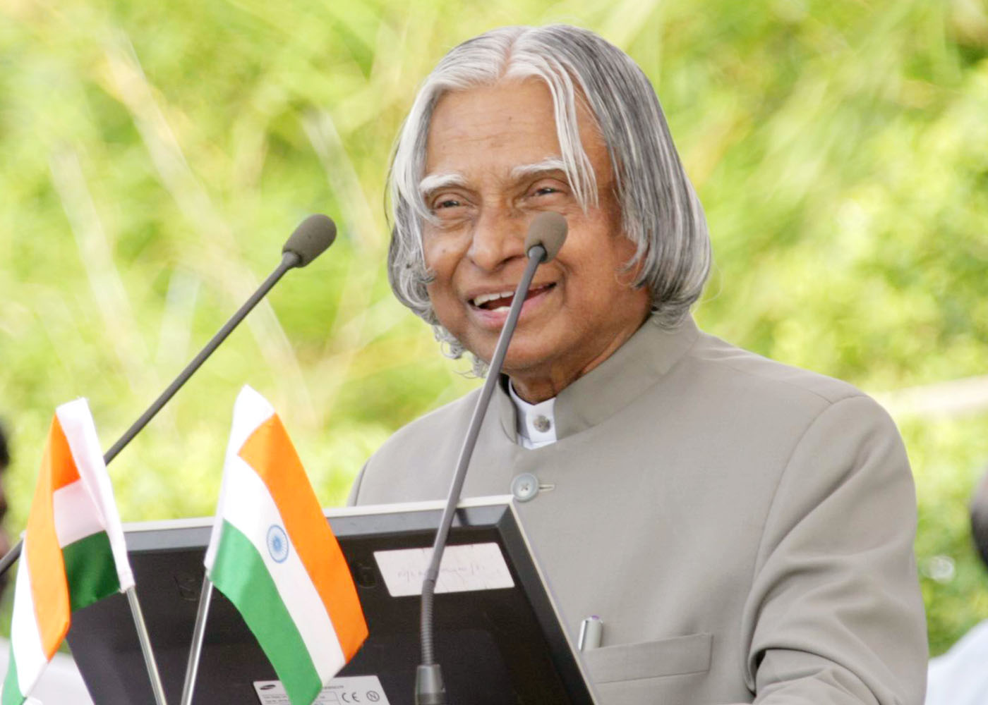
Believing in yourself is the first secret to success.
Abdul Kalam
This Photo by Unknown Author is licensed under CC BY-NC-ND

Slide 3
If you believe within your heart you’llknow that no one can change the path that you must go
Believe in yourself, right from the start
you will have brains
you will have heart
you will have courage
to last your whole life through
Believe what you feel
and know you’re right, because
time will come around
when you say it’s yours

Slide 4
make the most of yourself, for that is all there is of you. ~Ralph waldo emerson
You have one chance to make an impression.
There is no dress rehearsal,so prepare for your performance.
Learn to market YOU.
The difference between you and the celebrity is you are agent,manager,public relation,lamo driver.

Slide 5
Other people’s opinion of you does not have to become your reality. ~les brown
Don’t let others judge you
Don’t believe the hype coming from friends
You are greater than you think you are

Slide 6
what a man thinks of himself, that it is which determine,or rather indicates his fate. ~henry David thoreau
The message you tell yourself need to be affirming and positive
If you believe you’re a failure, you will fail
If you believe you’re a quitter,you will quit
If you believe you’re a winner,you will win

Slide 7

This Photo by Unknown Author is licensed under CC BY

